Slide 1
NECPUC Symposium Demand-side considerations
May 21, 2024

Slide 2
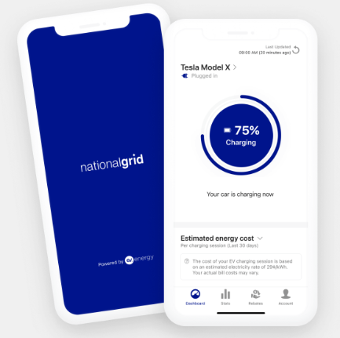
What programs do we offer in MA today as demand-side resources to help mitigate peak load growth?
Program | Summary | Link
Energy Efficiency | Incentives to customers to install measures that improve the energy efficiency of their homes or businesses | NG MA Energy Efficiency
EV Managed Charging | Enrollment incentive and rebates to customers for charging during off-peak hours | EV Managed Charging

Slide 3
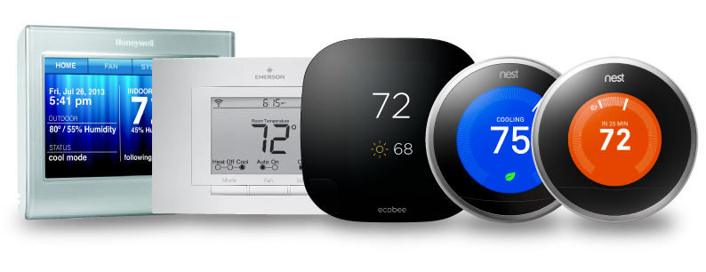
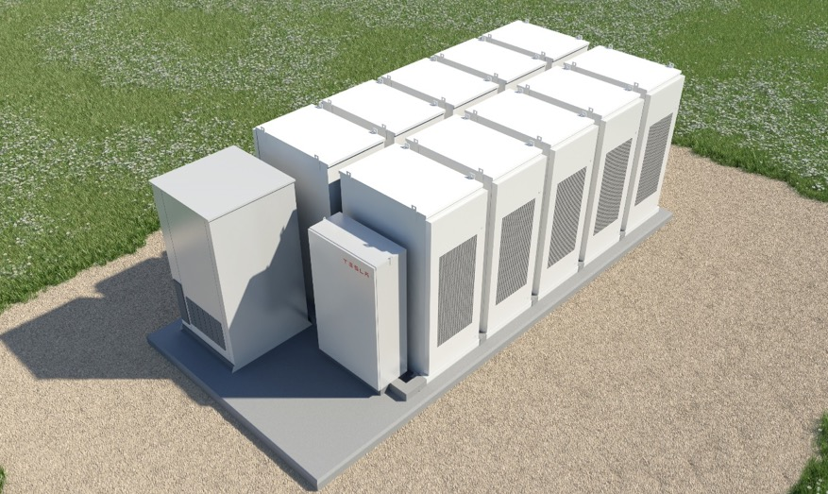
What programs do we offer in MA today as demand-side resources to help mitigate peak load growth?
Program | Summary | Link
Demand Response programs | Incentives to customers to reduce peak load (residential thermostats, batteries, C&I technology-agnostic curtailment) | ConnectedSolutions
 | Residential |  | Commercial & Industrial
Product | Wi-Fi Thermostats | Batteries | Summer Targeted Dispatch | Daily Dispatch
Incentive Structure | $50 for signing up and $20/year | ~$1,500/year depending on the system | $35/kW – summer | $200/kW – summer
# of Events/Year | 15 | 30-60 | 2-8 | 30-60

Slide 4
How can we “bend the curve” with demand-side resources to mitigate future winter peaking challenges?
Continuation of EE programs (e.g., weatherization) to permanently reduce peak load
Drive more adoption and program enrollment in resources that could support load flexibility for future winter peaks through:
Continued growth of system-wide DR and EV managed charging programs
Generac Grid Services DOE Grant project – provide 2K heat pumps, thermostats and batteries to income-eligible customers to mitigate peak demand during summer and future winter peaks (across MA w/ other utilities)
New local grid services / offerings to leverage customer and third-party DER flexibility to help address distribution grid constraints (proposed in National Grid’s Future Grid Plan)
Price signals via time-varying rates
Future cost-effective winter DR
Explore innovative technologies

