Slide 1
WATT Coalition
Working for Advanced Transmission Technologies
GETs complement traditional transmission expansion

Slide 2
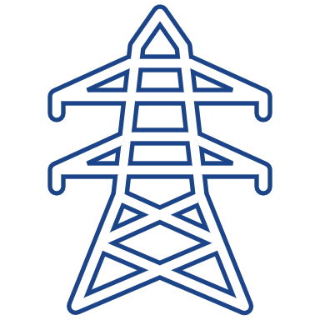
High-Performance Conductors
Carbon and composite core, overhead, bare conductors that use a trapezoid shaped wire of annealed aluminum.
Superconductors use a class of metallic compounds with negligible resistive losses cooled using liquid nitrogen.
Increased
Capacity
Greater
Efficiency
Additional
Resilience
Reduced
Land Impacts
~2x for composite core conductors
~5x for superconductors compared to conventional conductors
Composite core conductors can reduce energy losses by 30%
Superconductors can reduce losses by 50-80%.
Composite core conductors are stronger and sag less. Superconductors are actively cooled, meaning the say does not vary with ambient temperatures.
Reconductoring and rebuilds utilize existing ROWs and high-performance conductors can reduce the number of transmission towers for new builds.

Slide 3
US Federal Policies in Effect
Federal Power Act Section 219(b)3 (2005)
"[FERC] shall establish, by rule, incentive-based (including performance-based) rate treatments" to “Encourage deployment of transmission technologies and other measures to increase the capacity and efficiency of existing transmission facilities and improve the operation of the facilities”
Yet to be specifically implemented
FERC Order No. 881 (2021)–Line ratings
Ambient adjusted ratings (AAR) requirement
RTO/ISOs to accept Dynamic Line Ratings (DLR) by July 2025
(FERC considering DLR next)
FERC Order No. 2023 (2023)–Generator interconnection
Requires transmission providers to evaluate GETs and advanced conductors
FERC Order No. 1920 (2024)–Regional transmission planning and cost allocation
Requires transmission providers to consider DLR, power flow control, advanced conductors.

Slide 4
GETs Deployment Benefits
Advanced Power Flow Control | Topology Optimization | Dynamic Line Ratings
2022 UK: Unlocked 1.7 GW network capacity in UK, saving ratepayers $500M | 2016 PJM analysis: could reduce day-ahead energy costs by $145m/year | 2022 Pennsylvania: DLR increases line capacity by 25% on average.
2023 New York: Unlocked capacity for 185 MW of generation, with $10M+ savings over legacy tech | 2022 SPP ex-post: could resolve 98% of overloads in utility’s territory | 2012 Belgium: DLR increases capacity by 20%+ over 90% of the time

Slide 5
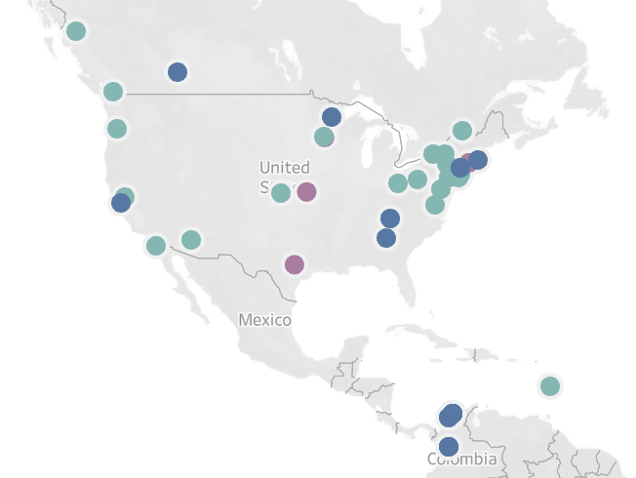
GETs adoption in the US – many pilots, few in operations

