Slide 1


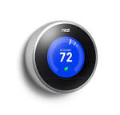







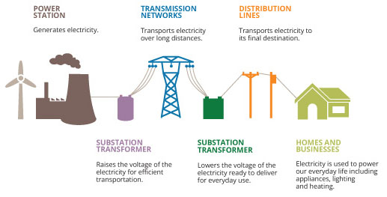
Electricity and delivery model is changing
Policy and technology are shrinking the distance between supply and demand of electricity.
Customer Energy Service Providers
Political and Technological forces
Historical Utility Delivery
Traditional utilities are losing customer relationships. The utility of the future should endeavor to provide these services.

Slide 2
Making the Transition from Utility to
Integrated Energy Service Provider
Utility
Integrated Energy Service Provider
Poles and Wires
Investment
Generation
Customer Energy Services
Time

Slide 3

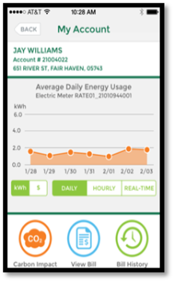


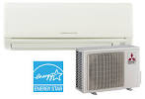


Integrated Smart Home/Business
Bundle a whole home/business energy solution through key partnerships.
Garner new revenue from equipment financing and partner fees
Create customer “stickiness” through deeper involvement and commitment
Future Potential GMP Solar
GMP Billing/ Automation
Weatherization
GMP Financing
Efficiency Vermont Rebates

Slide 4

Energy
Home of the
Future

